Slide 1
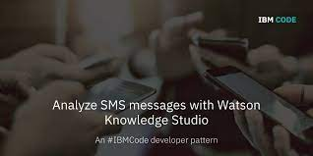

Slide 2

Analyze SMS Messages With Watson Knowledge Studio
DEPARTMENT OF COMPUTER SCIENCE AND ENGINEERING
Under the guidance of
Dr. G.V.S.N.R.V. PRASAD, MTech, M.S, PhD
Professor and Principal, Department of CSE
BY
Ch. Sadhana 18481A0537
Ch. Subhash 18481A0548
B. Manju Pavani 18481A0533

Slide 3
INTRODUCTION
This code pattern describes how to analyze SMS messages using Watson Knowledge Studio and Watson Natural Language Understanding to extract entities in the data. Specifically, the code pattern explains how to use Watson Knowledge Studio to create and train a machine learning model using human annotated documents, integrating the machine model into an NLU service, and extracting domain-specific entities using this NLU service.
The SMS messages in this code pattern are related to merchants offering special offers to their customers. With NLU, you can extract some general information from each text, but you might want to add the capability to extract additional specific data, such as what the offer is, who the merchant is, how long the offer is valid, and what the merchant’s phone number and website is. You can accomplish this by loading sample messages into WKS and training it to recognize entities within each text. The result is a model that you can then use to process additional messages.

Slide 4
For example:
PIZZA! Don't Cook Wednesdays are here! Get 50% off a Medium Pizza.
Offer available for single Pizza in-store and two for Home Delivery.
Walk-In/Call @ 555-555-5555
The example above has a few interesting entities which could not be extracted with conventional NLP techniques, but by using Watson services we can find out the following:
What is the offer?
Who is the merchant?
What is the offer name?
What is the offer's validity period?
What is the merchant's phone number?
What is the merchant's website?

Slide 5
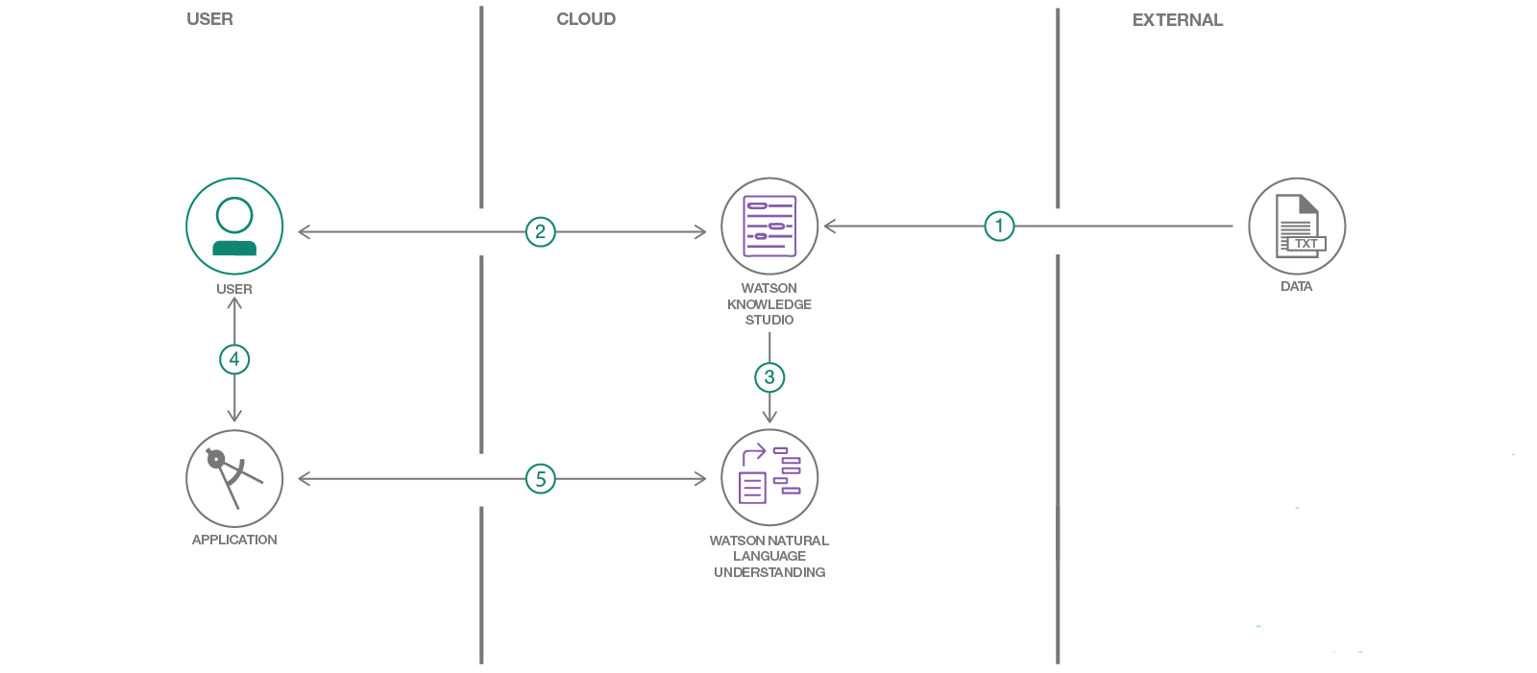
TECHNICAL ARCHITECTURE:
Load type system and corpus files into Watson Knowledge Studio.
A user generates a model by training and evaluating data.
The WKS model is deployed to Watson NLU.
A user provides an SMS message to the app for analysis.
The SMS message is analyzed by Watson NLS for processing and returns extracted domain specific entities based on the WKS model are returned.

Slide 6
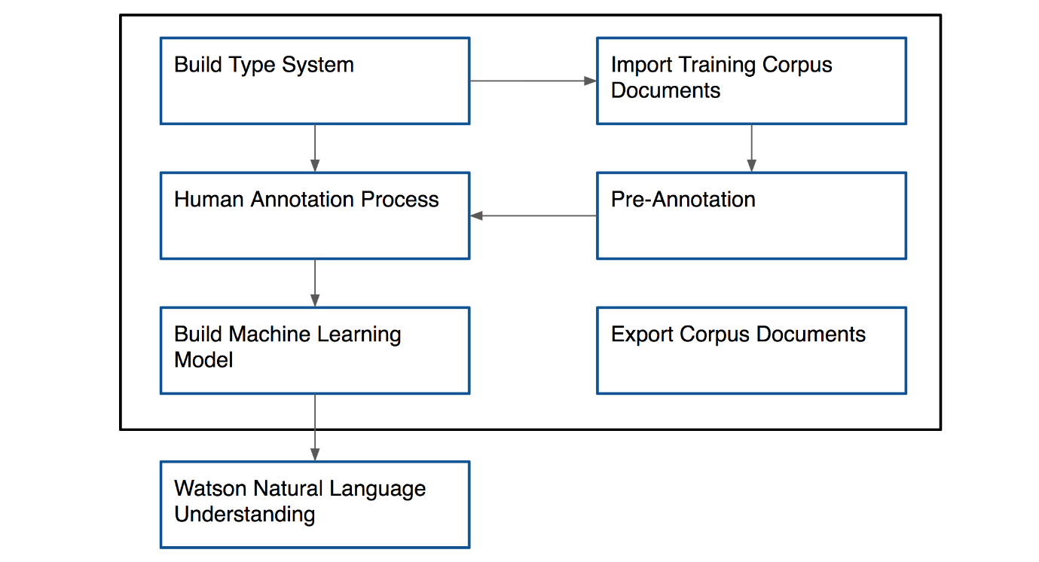
HOW DOES WATSON KNOWLEDGE STUDIO WORK?
In short, a type system is built and supporting documents are uploaded that have domain specific wording. From here a model must be built to properly understand the documents, this is where the annotations come in. Once the corpus and annotations are set you are free to create a model and deploy it to a Watson Natural Language Understanding instance.

Slide 7
PROJECT FLOW
The project flow contains the following steps
Create IBM account
Log in to IBM Account
Create Watson Knowledge Studio and Watson Natural language Understanding Services
Load entity type system and Training data files into Watson Knowledge Studio.
Generate model by training and evaluating data.
The WKS model is deployed to Watson NLU.
Build Node-RED application (UI)
A user provides an SMS message to the app for analysis.
The SMS message is analyzed by Watson NLS for processing and returns extracted domain-specific entities

Slide 8
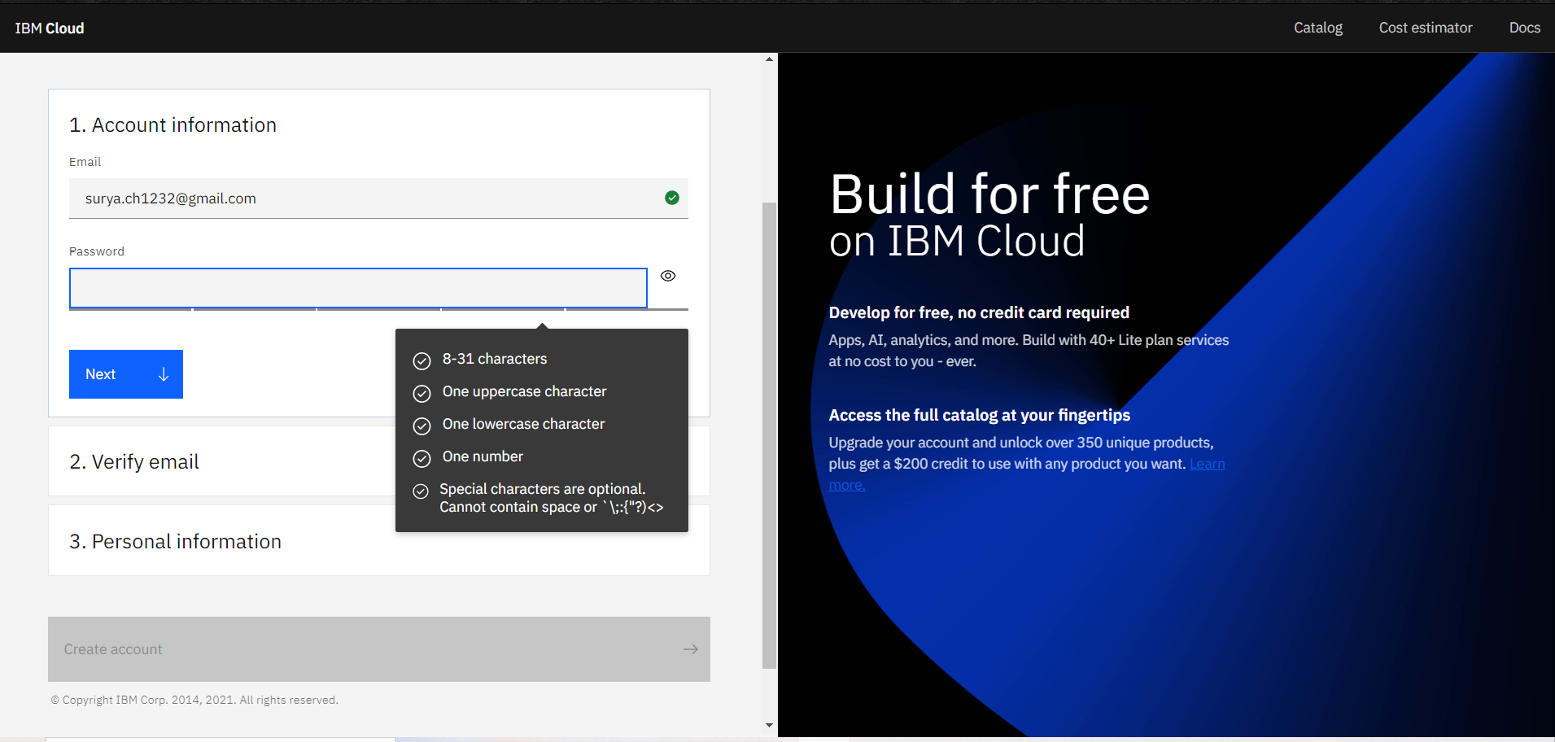
PREREQUISITES
To complete this project you must have an IBM account
Step1:-
Open IBM cloud and register with your respective email
Step2:-
Set the password as per the given instruction in the password field

Slide 9
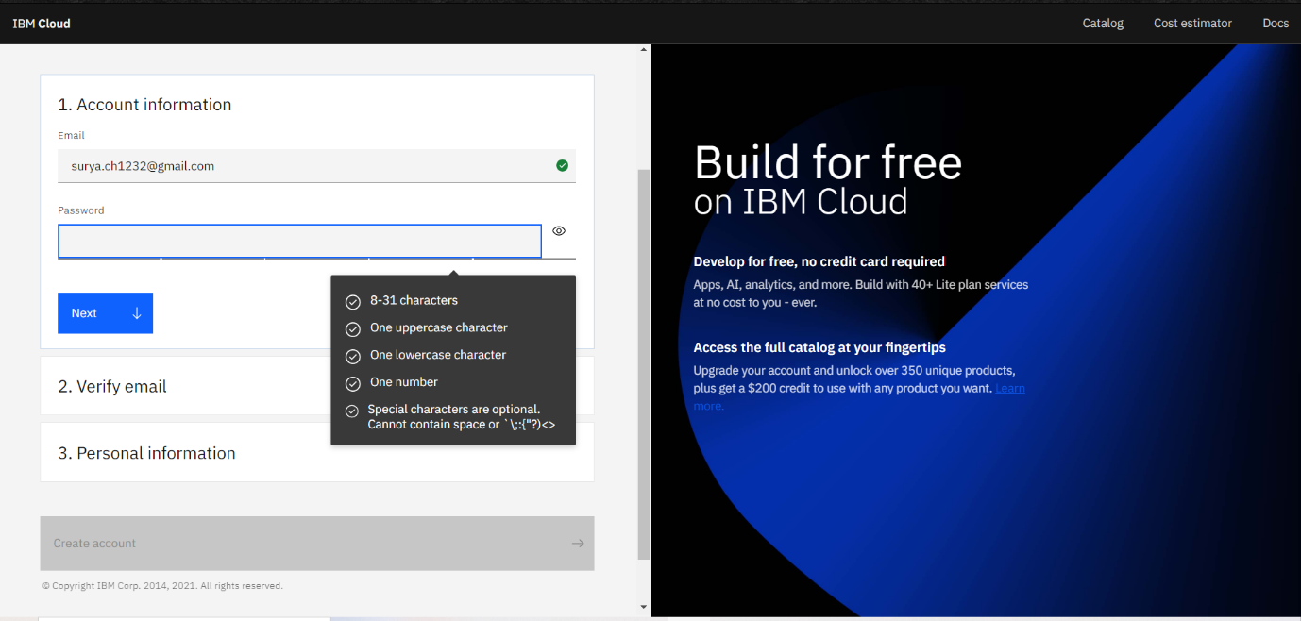
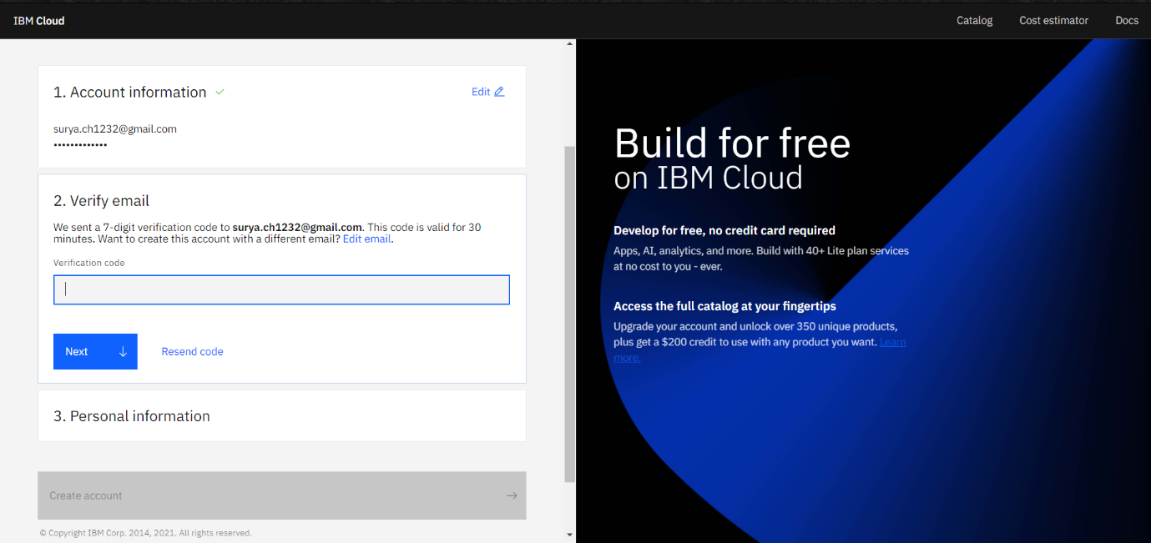
Step3:-
Then a verification mail sent to your respective registered email.Open the mail and verify with the given code in the mail.
Step4:-
Enter your personal information according to your choice and finish your registration.

Slide 10
CREATE IBM SERVICES
For this project, you should create the following services
Watson Knowledge studio:- Teach Watson the language of your domain with custom models that identify entities and relationships unique to your industry, in unstructured text. Use the models in Watson Discovery, Watson Natural Language Understanding, and Watson Explorer.
Watson Natural Language Understanding:- An IBM Cloud service that can analyze text to extract meta-data from content such as concepts, entities, keywords, categories, sentiment, emotion, relations, semantic roles, using natural language understanding.
Node-RED :- Node-RED is a flow-based development tool for visual programming developed originally by IBM for wiring together hardware devices, APIs and online services as part of the Internet of Things. Node-RED provides a web browser -based flow editor, which can be used to create JavaScript functions.

Slide 11
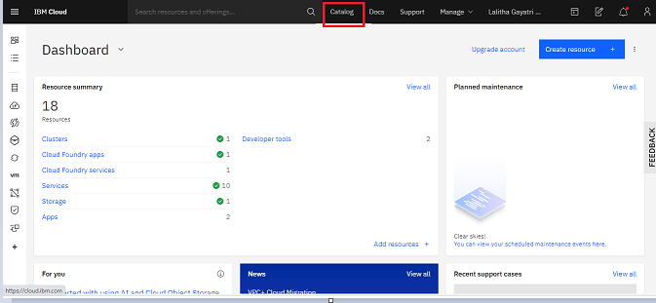
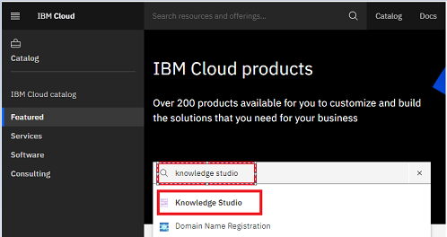
CREATE KNOWLEDGE STUDIO SERVICE
Step1:-
Once you login into IBM account you will get redirected to the IBM dashboard page
From top right click on catalog
Step2:-
Search for Knowledge Studio
Select Knowledge Studio service

Slide 12
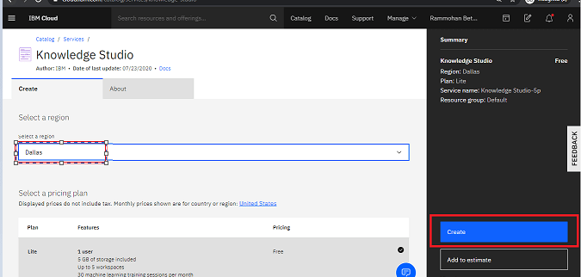
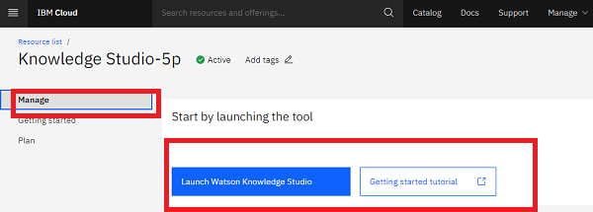
Step3:-
you will get redirected to the creation page.
Select Region as Dallas.Click on create .
Step4:-
Your service is created and your Knowledge studio service launch page looks like

Slide 13
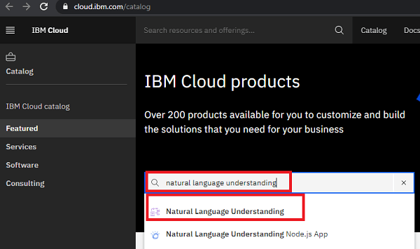
CREATE NATURAL LANGUAGE UNDERSTANDING SERVICE
Step1:
open IBM dash board in another tab.
From top right click on the catalog
Step2:-
Search for Natural language Understanding
Select Natural language Understanding service

Slide 14
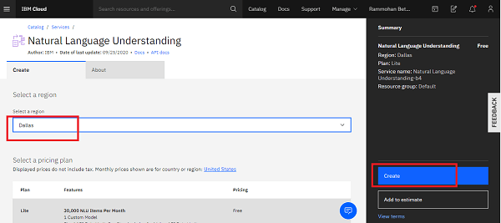
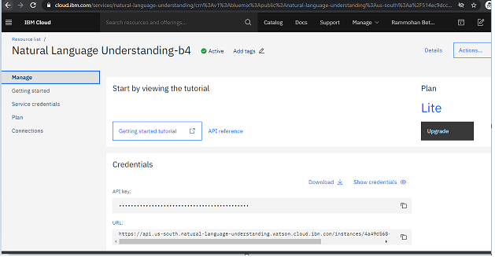
Step3:-
Your service creation pages pops up
Select the region as Dallas.Click on create
Step4:-
Your service launch page looks like

Slide 15
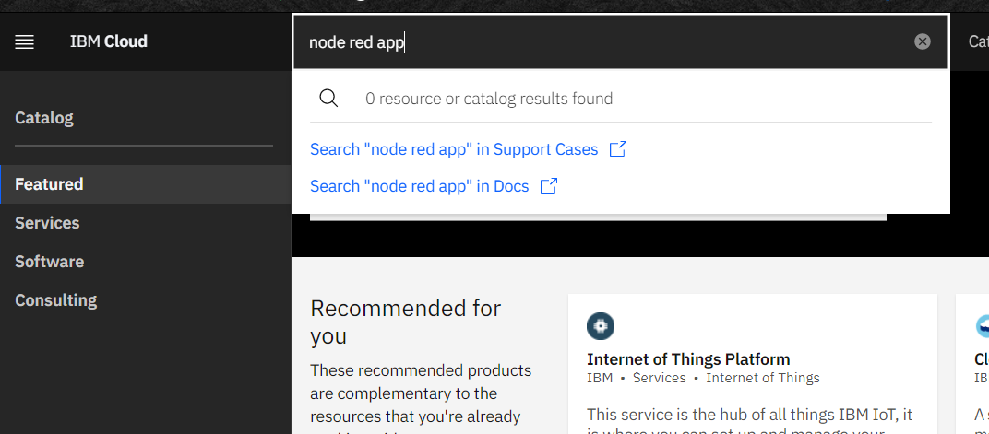
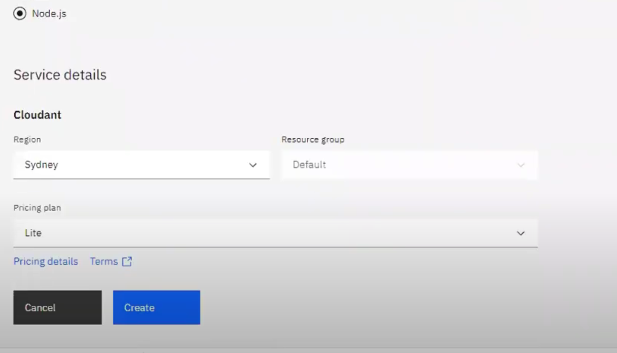
CREATE NODE-RED SERVICE
Step1:-
Log in to IBM Cloud.Open the catalog and search for node-red.
Click on the Node-RED App tile.
Step2:-
Click the Create button to continue. This will create your application, but it is not yet deployed to IBM Cloud

Slide 16
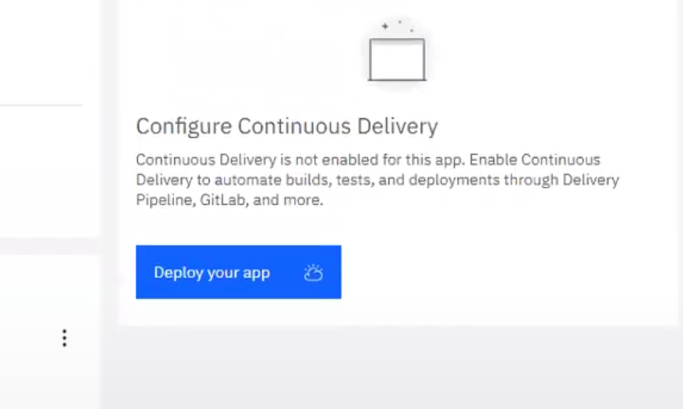
Step3:-
On the next screen, click the Deploy your app button to enable the Continuous Delivery feature for your application.
Step4:-
You will need to create an IBM Cloud API key to allow the deployment process to access your resources. Click the New button to create the key. A message dialog will appear. You can accept the default values and confirm to close the dialog.
The Node-RED Starter kit only supports deployment to the Cloud Foundry space of IBM Cloud. Select the region to deploy your application to. This should match the region you created your Cloudant instance in. Lite users might only be able to deploy to your default region.

Slide 17
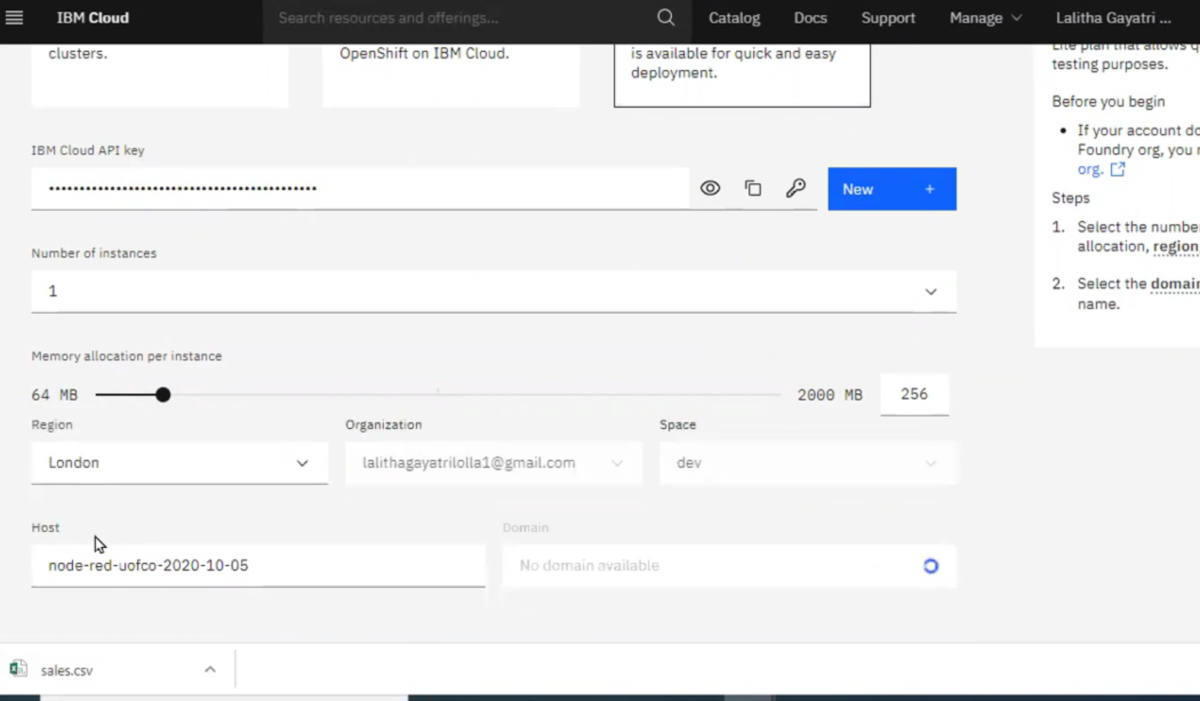
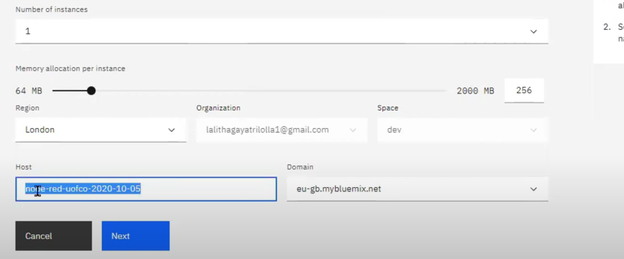
Click Next to continue.

Slide 18
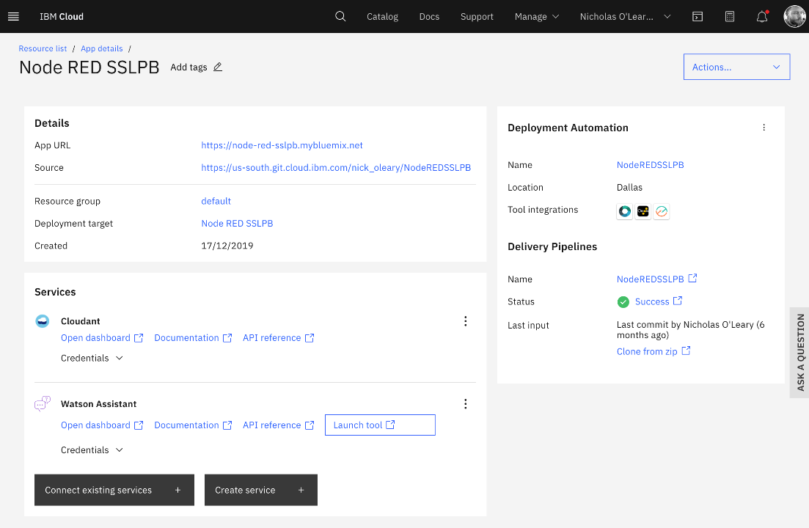
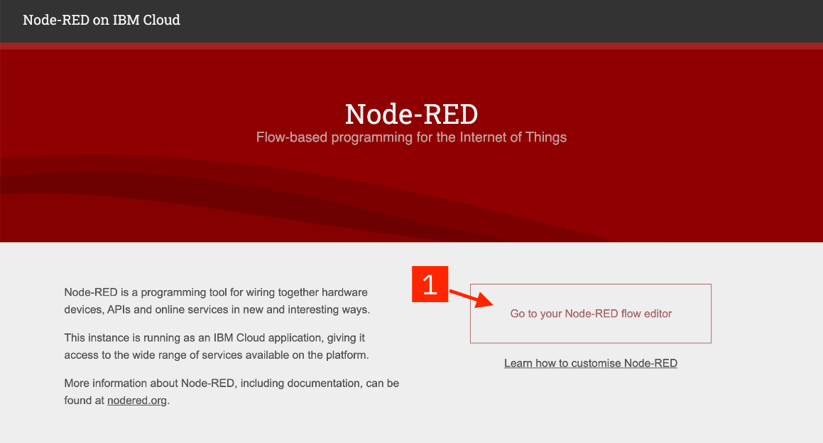
Step5:-
After a few moments, the Deployment Automation section will refresh with the details of your newly created Delivery Pipeline. The Status field of the pipeline will eventually show In progress. That means your application is being built and deployed.Now that you’ve deployed your Node-RED application, let’s open it up!
Step6:-
Node-RED will save your changes and then load the main application. From here you can click the Go to your Node-RED flow editor button to open the editor.

Slide 19
BUILD CUSTOM MODEL
In this activity, you will be building a custom model for domain-specific entities. In this milestone you should complete the following tasks:
Create a workspace
Upload entity types
Upload training data
Annotate the documents
Train and evaluate the model
Deploy model in NLU
1.CREATE A WORKSPACE
Step1:-
A workspace defines all the resources that are required to create a machine learning model, including training documents, the type system, dictionaries, and annotations that are added by human annotators.
From Knowledge, studio service page click on Launch Watson Kanowledge Studio.

Slide 20
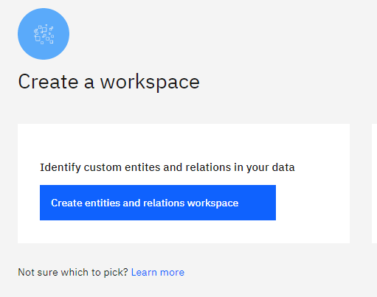
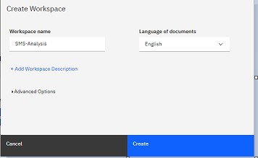
Step2:-
Click on create entities and relation types
Step3:-
Give a name for ex: Sms-analysis and click on create

Slide 21
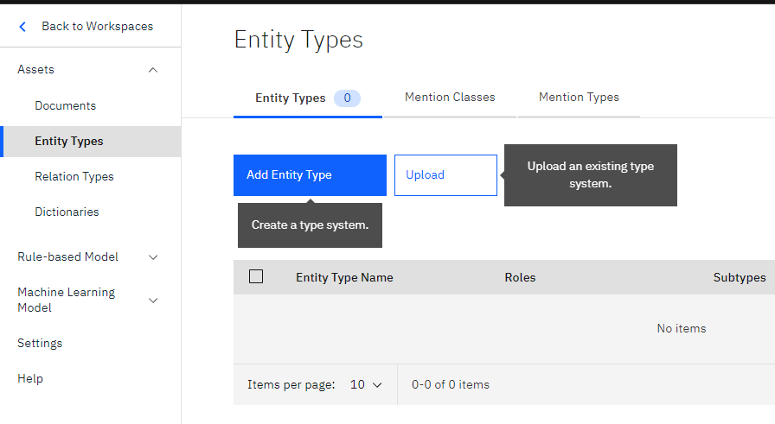
Step4:-
You will be redirected to a page which looks like below
2 UPLOAD ENTITY TYPES
Step1:-
For this project, we have created a JSON file named Entitytypes file which has all the entities that can be extracted from an SMS for example (offer, merchant, coupon code, etc.,)
Select the Entity types option from the left pane.Click on upload

Slide 22
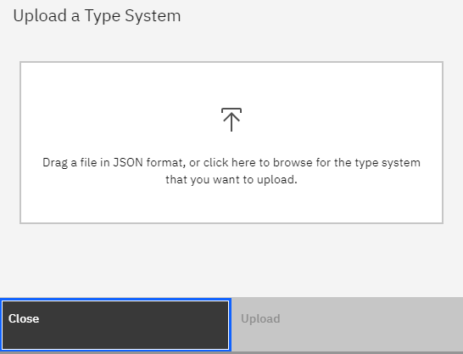
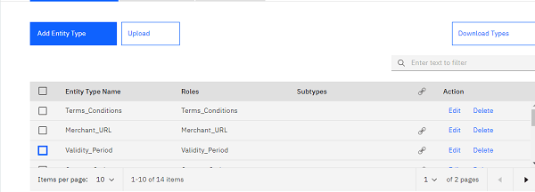
Step2:-
Pop-up displays, browse for entytypes.json file and click on upload
Step3:-
you can see all the entities are uploaded to type system
After you finish uploading entity types to the type system, you can begin adding documents(training data) to your workspace.

Slide 23
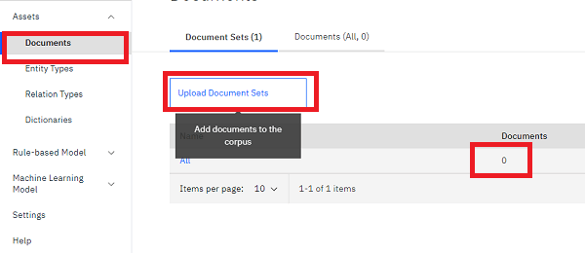
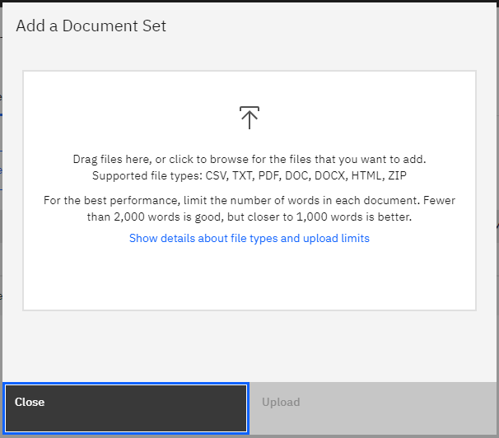
3. UPLOAD TRAINING DATA
Step1:-
Now click on Documents from the left pane you can see there is no training data
Now click on upload document sets
Step2:-
Browse for training data.zip file and click on upload

Slide 24
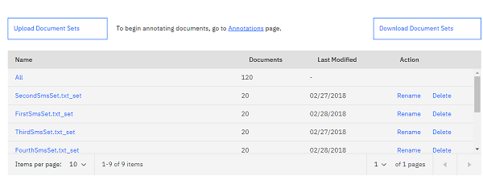
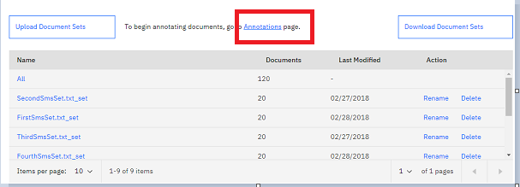
Step3:-
You can see all the training data is been uploaded
4. CREATE ANNOTATION TASK
Step1:-
Now let us annotate the documents (train data) with the uploaded entities
click on the annotation page as shown below

Slide 25
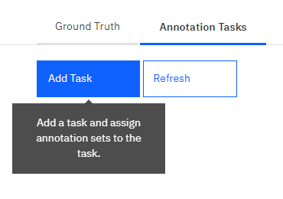
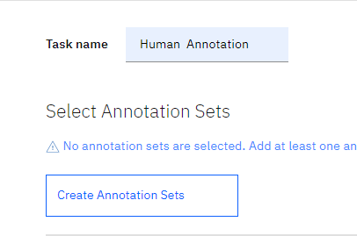
Step2:-
Select Automation tasks and select Add Task
Step3:-
Now Give a name to the task as shown in the figure and click on create annotation sets

Slide 26
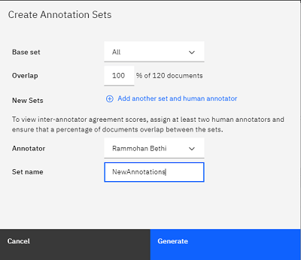
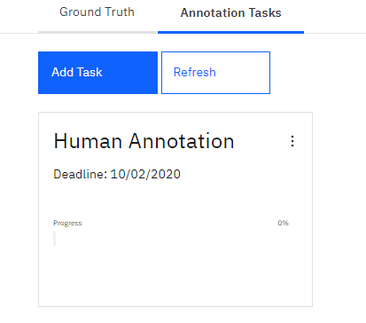
Step4:-
A window pops up select All as an option in Base set, select the owner and give a name as NewAnnotations to your annotations
Click on generate
Step5:-
Now click on save at the top right corner, you will redirect to a page which looks like this
You can see progress is zero , now lets annotate the document sets

Slide 27
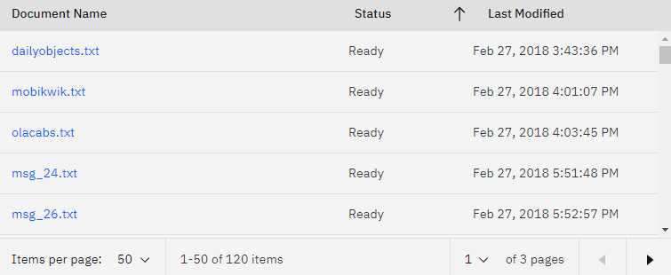
5.ANNOTATE DOCUMENT SETS
Step1:-
Double click on the Human automation task
You will redirect to a page where click on the annotate option
Step2:-
You will redirect to a page which looks like this

Slide 28
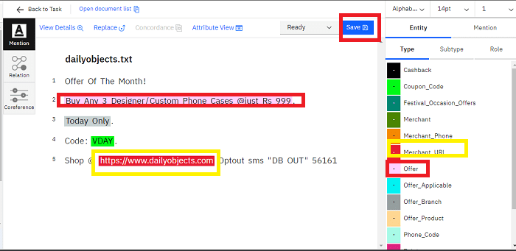
Step3:-
You can see the status as ready for all the documents, the reason is IBM has an internal annotator which will make all the annotations ready for us. But if you want to create your own annotations click on any of the documents for example click on daily object.txt
you will get redirected to a page where you will find some text for annotation and entity types lies towards the right
Select the text and give the appropriate annotation to the selected text , once annotation is done click on save repeat this for all the documents.
once annotation is done click on Open Doccumentlist. you will get redirected to the previous page

Slide 29
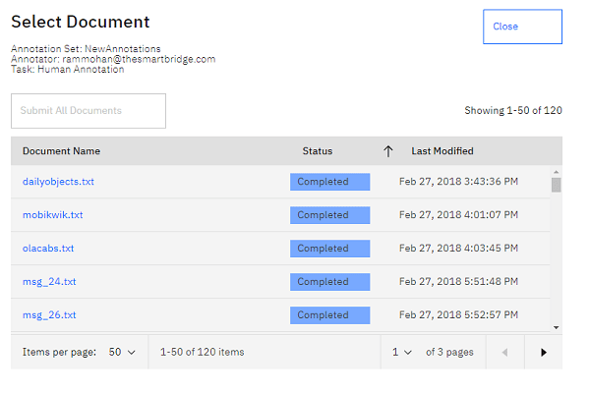
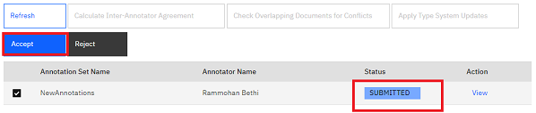
Step4:-
Click on submit All documents and you will get redirected to this page, click on close
Step5:-
Now click on the back to task option from top.You will get redirect to a page looks below.
Select the checkbox and click on accept.The submitted status changes to completed
Now you have completed your Annotations lets train these annotations

Slide 30
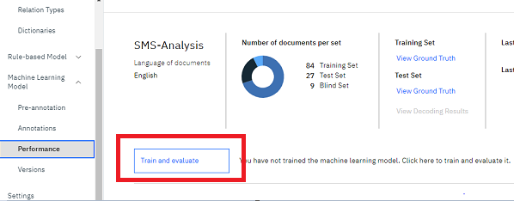
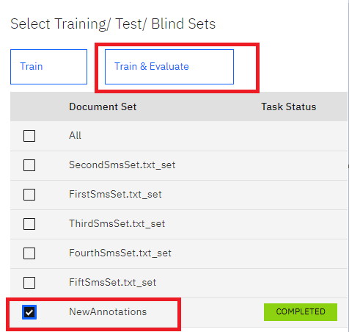
6.TRAIN THE ANNOTAATIONS
Step1:-
Click on Performances then you will find an option called to train and evaluate .
Click on train and Train and evaluate
Step2:-
select the annotation set that you have submitted and click on the train and evaluate button. it will take about 10 to 15 minutes for training

Slide 31
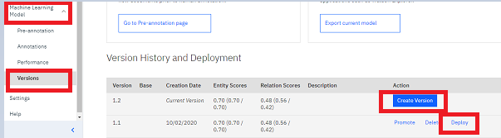
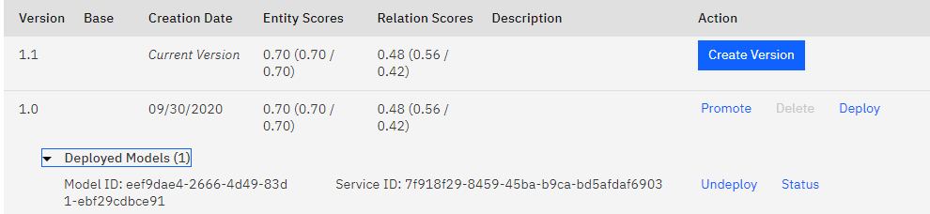
7.DEPLOY THE IN NLU SERVICE
Step1:-
Click on machine Learning --> select version --> click on create version
a window pops up, click on ok
Version is created. Click on deploy
Step2:-
once the model is deployed a model ID is generated
we can use this model id in we or android applications

Slide 32



